Slide 1
ITCS 3134
YINHANG KWOK
800831787
E06 - Histograms

Slide 2
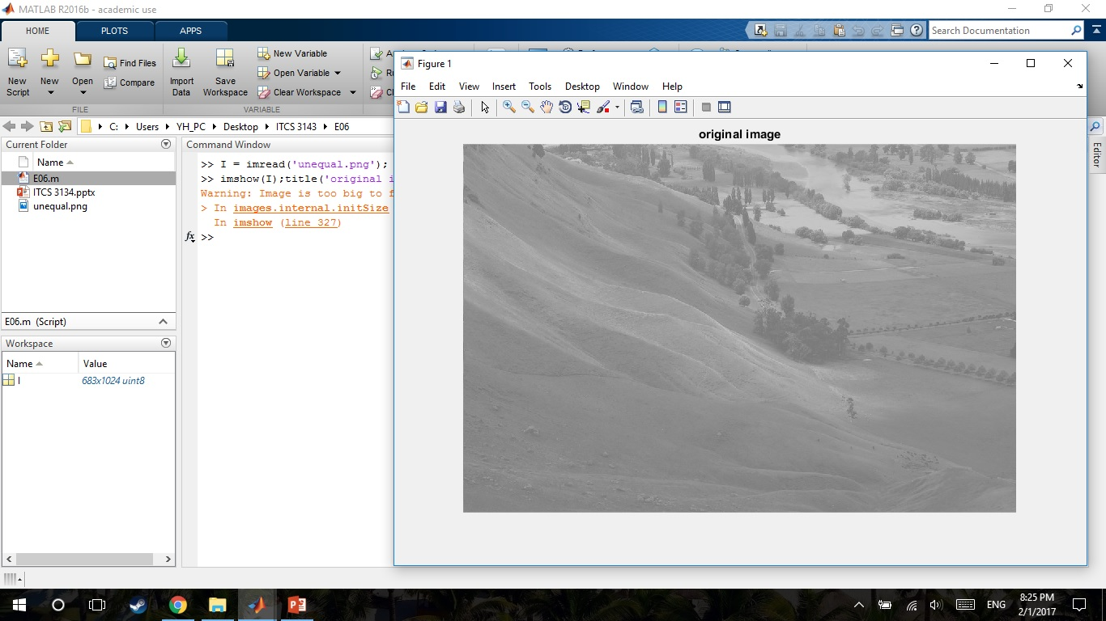
input image
I = imread('unequal.png');
imshow(I);title('original Image');

Slide 3
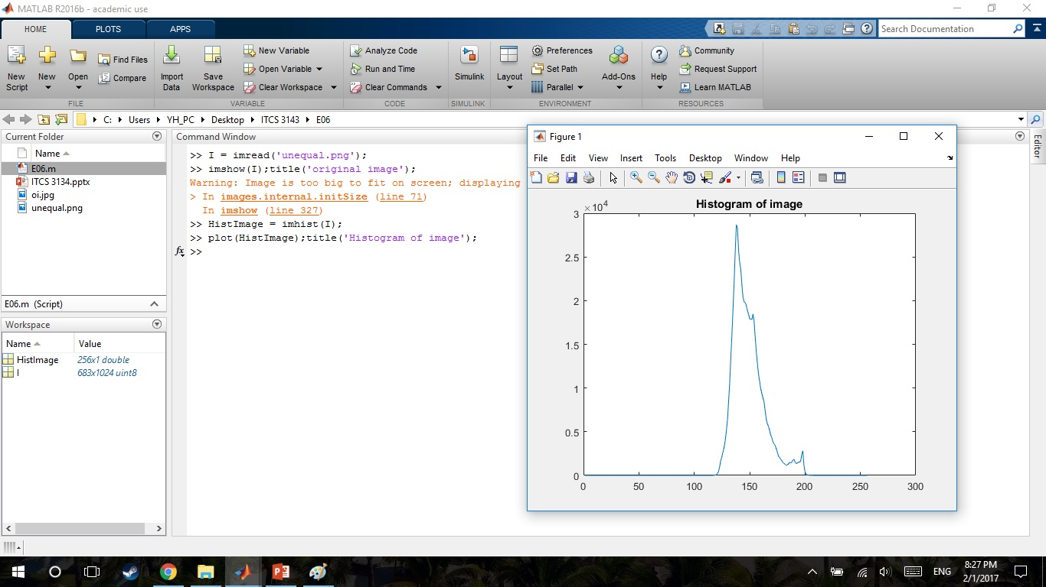
Histogram of input image
HistImage = imhist(I);
plot(HistImage);title(‘Histogram of image');

Slide 4
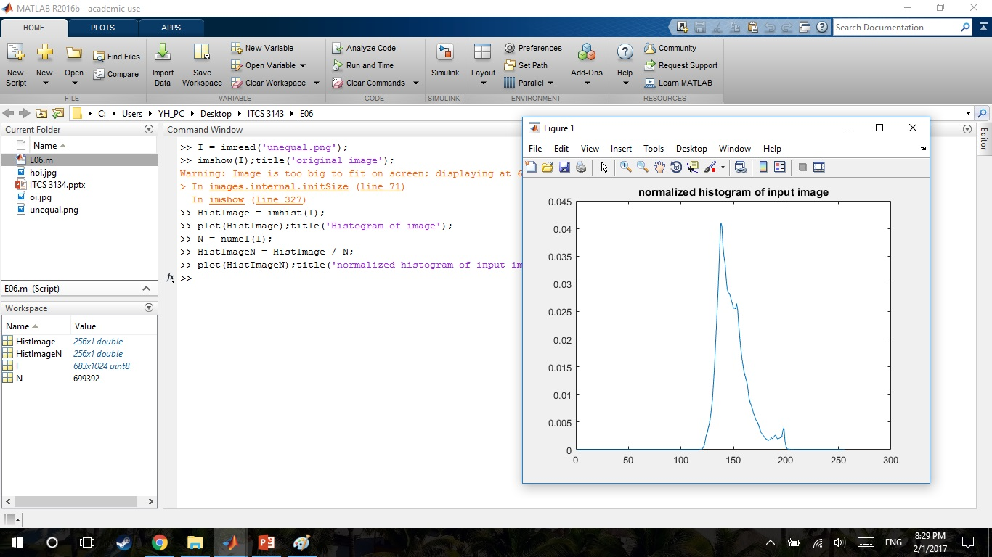
normalized histogram of input image
N = numel(I);
HistImageN = HistImage / N;

Slide 5
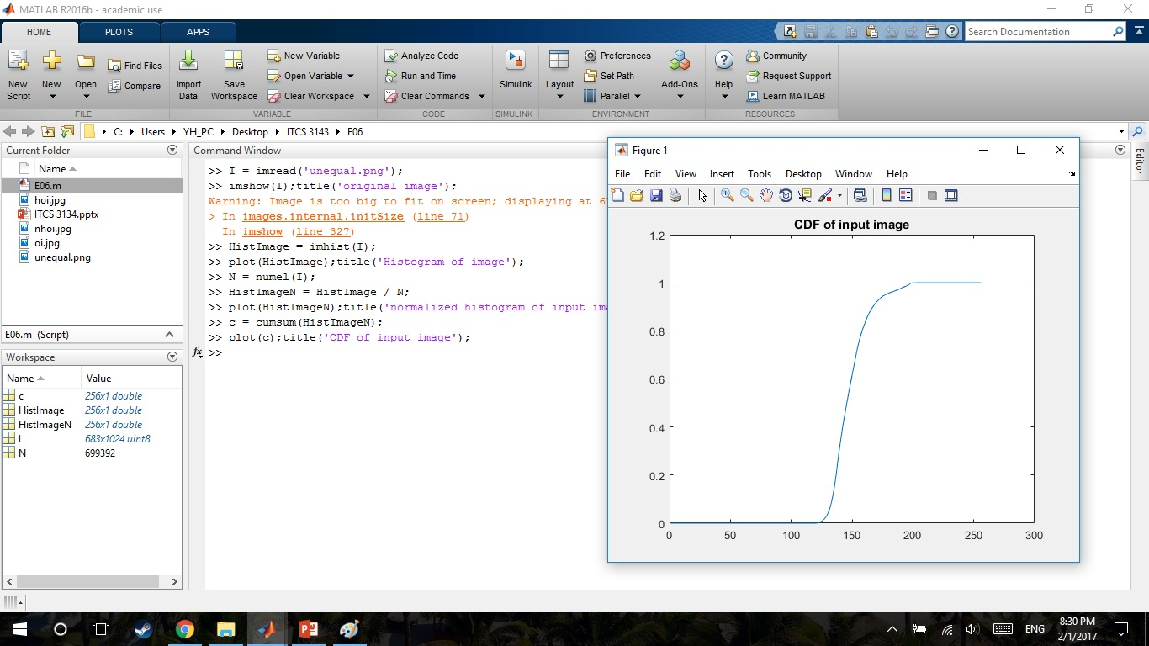
CDF of input image
c = cumsum(HistImageN);
plot(c);title('CDF of input image');

Slide 6
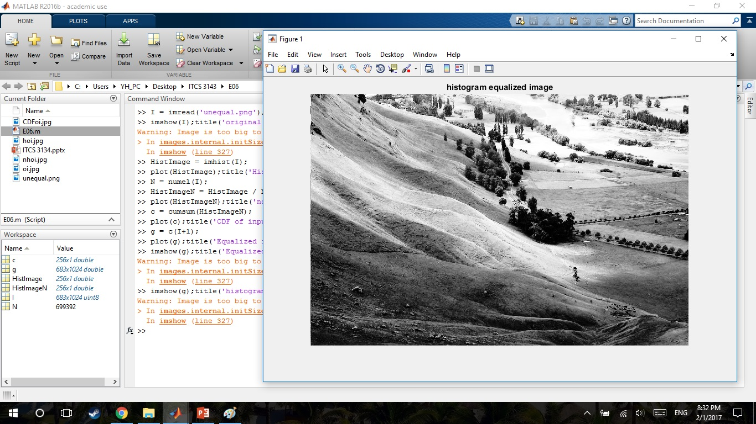
Equalized image
g = c(I+1);
imshow(g);title('histogram equalized image');

Slide 7
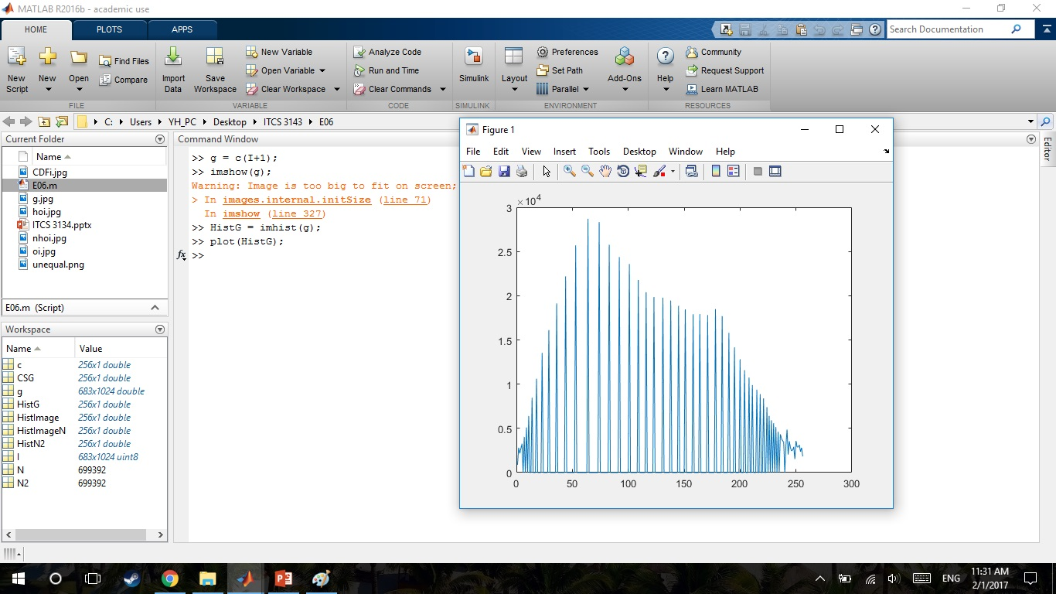
Histogram of equalized image
HistG = imhist(g);
plot(HistG);title('histogram of histogram equalized image');

Slide 8
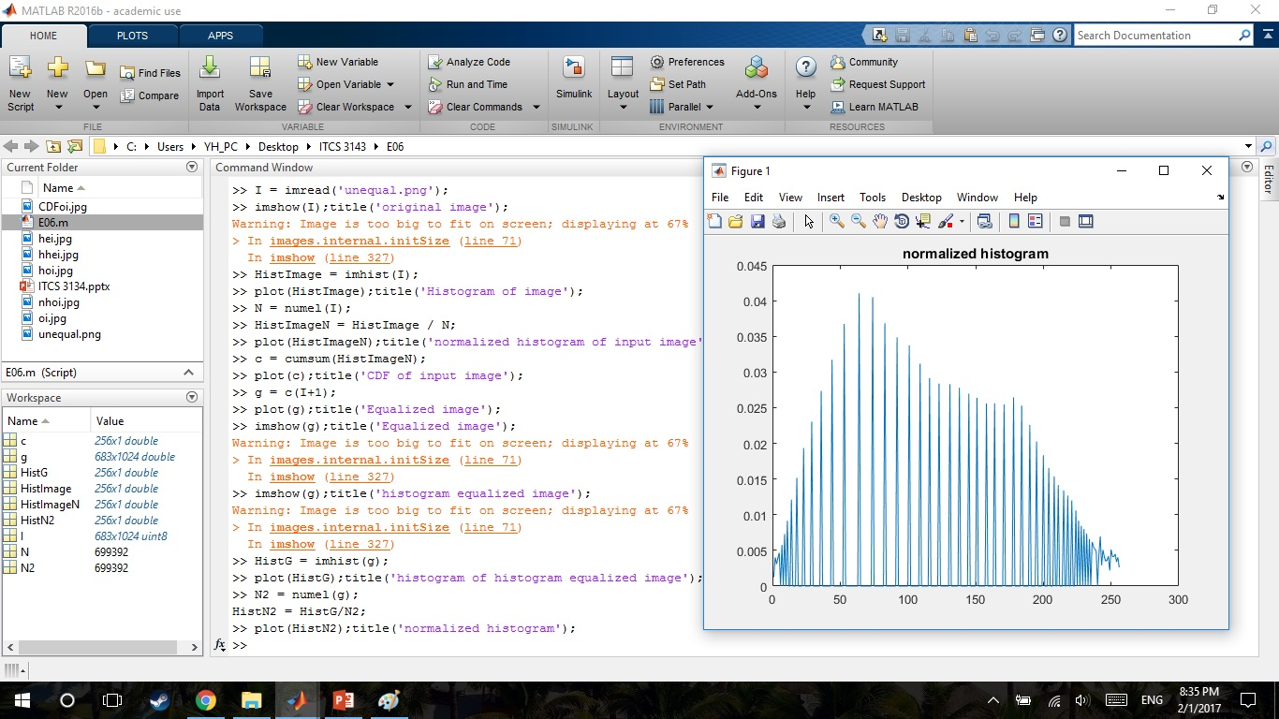
normalized histogram
N2 = numel(g);
HistN2 = HistG/N2;
plot(HistN2);title('normalized histogram');

Slide 9
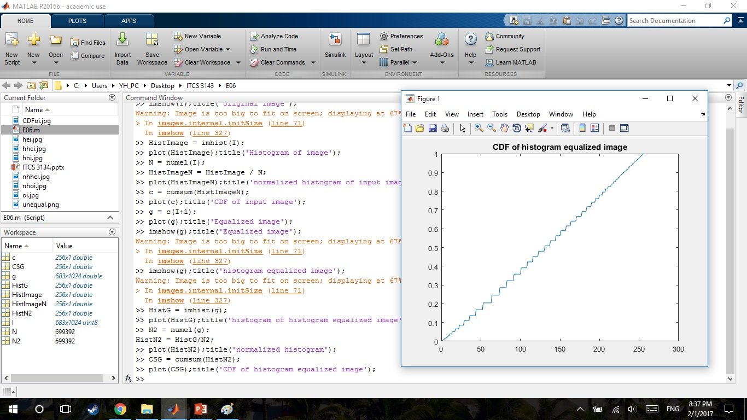
CDF of histogram equalized image
CSG = cumsum(HistN2);
plot(CSG);title('CDF of histogram equalized image');

Slide 10
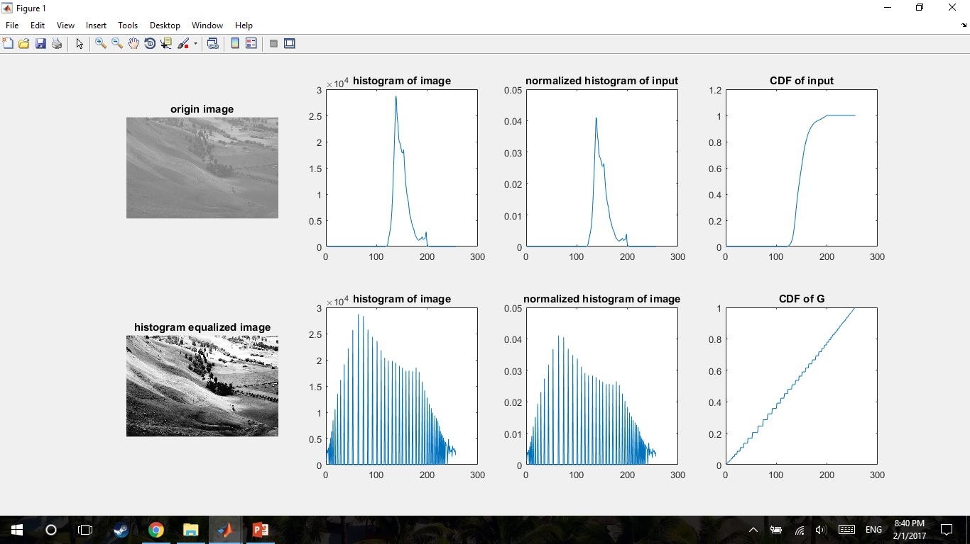
Result

